Slide 1
Lab 3 DNA: The Molecule of Life
BY-102
Zach Nolen

Slide 2
DNA Video

Slide 3
DNA Basics
Deoxyribonucleic Acid (DNA), can be thought of as the blueprint of the cell.
All information needed for the cell to function is contained in the DNA
DNA is usually a double stranded molecule that is organized into a double helix

Slide 4
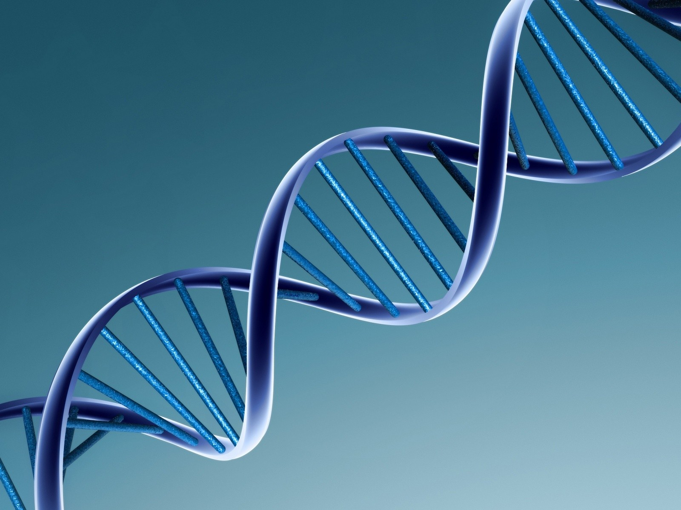
DNA Structure
Notes:
Picture Reference:
http://www.forbes.com/sites/daviddisalvo/2011/11/22/whats-your-dna-worth/

Slide 5
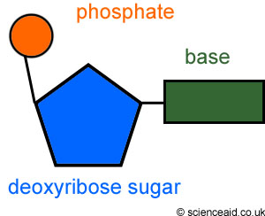
DNA Structure
DNA is composed of nucleotides which are composed of three different subunits
Notes:
Picture Reference:
http://dna02.wikispaces.com/Structure+of+DNA+nucleotides

Slide 6
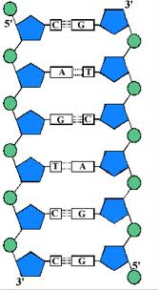
DNA Structure
Nucleotides are connected to form strands of DNA.
DNA strands run antiparallel to each other
Strands are connected by complementary base pairings (A=T; G=C)
Notes:
Picture Reference:
http://kootation.com/structure-of-dna.html

Slide 7
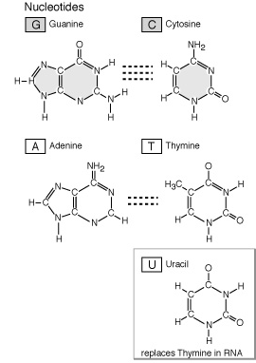
Nitrogenous Bases
There are four different bases in DNA
Adenine
Thymine
Guanine
Cytosine
In RNA, Thymine is replaced by Uracil
Notes:
Picture Reference:
http://www.ncbi.nlm.nih.gov/Class/MLACourse/Original8Hour/Genetics/nucleotide.html

Slide 8
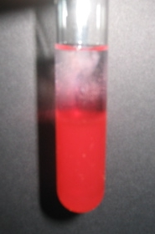
DNA Extraction Exercise
You have tubes of strawberry prep at your table.
Add cold ethanol located at your table to extract the DNA

Slide 9
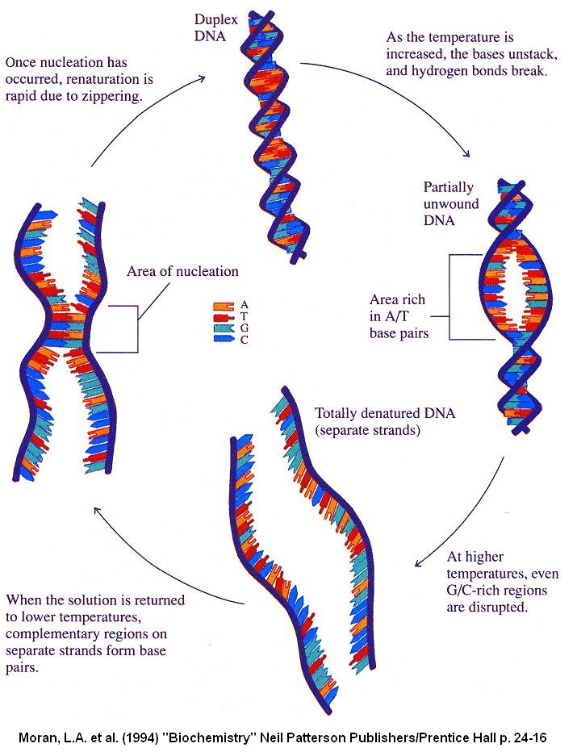
Denaturation
Denaturation is when DNA becomes unwound and the bonds holding the 2 strands together break.
This can happen because of temp or other substances
Notes:
Picture Reference:
http://sandwalk.blogspot.com/2012/01/paul-doty-1920-2011-and-dna.html

Slide 10
Denaturation Exercise
For this exercise, you will add NaOH to your test tubes of DNA to denature the DNA.

Slide 11
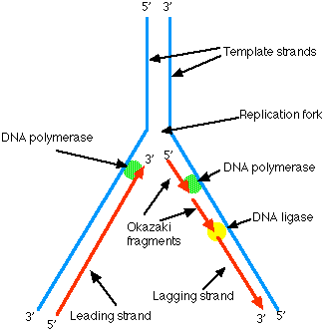
DNA Replication
Is a semi-conservative process.
Notes:
Picture Reference:
http://users.rcn.com/jkimball.ma.ultranet/BiologyPages/D/DNAReplication.html

Slide 12
Building DNA Exercise
In groups of 2, you will construct a piece of DNA using pop beads.
After you make your piece of DNA, you will replicate it. Each of you will get one half of the DNA and have to construct the complementary strand.
At the end, you should have 2 identical pieces of DNA

Slide 13
RNA Basics
Ribonucleic Acid (RNA), is used to convert information carried in the DNA into proteins to be used by the cell.
RNA is composed of the same subunits as DNA, with the exception of Uracil replacing Thymine and Ribose as the sugar in place of Deoxyribose.
RNA is typically single stranded.

Slide 14
Types of RNA
mRNA – messenger RNA
tRNA – transfer RNA
rRNA – ribisomal RNA

Slide 15
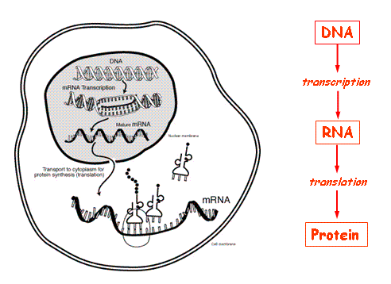
The Central Dogma
Notes:
Picture Reference:
http://www.ncbi.nlm.nih.gov/Class/MLACourse/Modules/MolBioReview/central_dogma.html

Slide 16
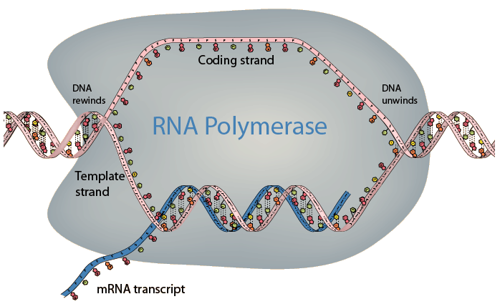
Transcription
The DNA is transcribed into mRNA which can leave the nucleus.
Notes:
Picture Reference:
http://hyperphysics.phy-astr.gsu.edu/hbase/organic/transcription.html

Slide 17
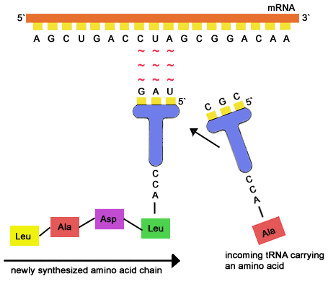
Translation
mRNA is translated into proteins by using tRNA, which recognize codons.
This process occurs in the ribosome
Notes:
Picture Reference:
http://www.cstephenmurray.com/onlinequizes/biology/DNA/replication,transcription,ortranslation.htm

Slide 18
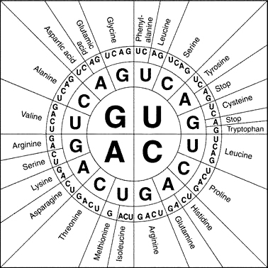
Codon Wheel
Notes:
Picture Reference:
http://rbssbiology11ilos.wikispaces.com/Codon+Wheel

Slide 19
DNA Handout
Work with your partner or table to complete the questions.
Color all images in the handout using the CORRECT colors listed on throughout the handout.
DNA Handout is due at the beginning of the next lab period

Slide 20
Review Questions
What is the basic unit of DNA?
What does DNA stand for?
What is the central dogma of genetics?
What is the start codon sequence?
What are the nitrogenous bases of DNA? Of RNA?

Slide 21
Before you leave lab
Clean up your work station

Slide 22
Before Next Lab
Complete sections of lab notebook to be turned in.
Complete DNA Handout
Read Lab 18
Do prelab

