Slide 1
The Structure and Function of Large Biological Molecules
Chapter 5

Slide 2
Molecules of Life
Despite the large diversity of life on Earth, most critically important molecules can be grouped into four main classes:
Carbohydrates
Lipids
Proteins
Nucleic Acids
These molecules are called macromolecules due to their relatively large size

Slide 3
Chapter Key Concepts
Macromolecules are polymers, built from monomers
Carbohydrates serve as fuel and building material
Lipids are a diverse group of hydrophobic molecules
Proteins include a diversity of structures, resulting in a wide range of functions
Nucleic acids store, transmit, and help express hereditary information

Slide 4
Definitions
Polymer - long molecule consisting of many similar or identical building blocks linked by covalent bonds
Monomer – the repeating units that compose polymers

Slide 5
Synthesis and Breakdown of Polymers

Slide 6
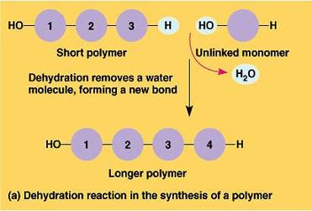
Dehydration Reactions
The connection of monomers through a reaction that results in a loss of a water molecule
Notes:
Picture Reference: http://chapter5macromolecules.wikispaces.com/Macromolecules

Slide 7
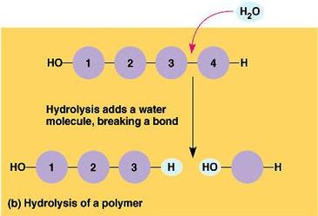
Hydrolysis Reactions
The break down of polymers into monomers through the addition of water
Notes:
Picture Reference: http://chapter5macromolecules.wikispaces.com/Macromolecules

Slide 8
Concept Check 5.1
What are the four main classes of large biological molecules?
How many molecules of water are needed to completely hydrolyze a polymer that is ten monomers long?

Slide 9
Chapter Key Concepts
Macromolecules are polymers, built from monomers
Carbohydrates serve as fuel and building material
Lipids are a diverse group of hydrophobic molecules
Proteins include a diversity of structures, resulting in a wide range of functions
Nucleic acids store, transmit, and help express hereditary information

Slide 10
Carbohydrates
Include both sugars and polymers of sugars
General formula for sugars is CXH2XOX
Monosaccharides are the simplest sugar, which are monomers that can be used to make more complex sugars (disaccharides and polysaccharides

Slide 11
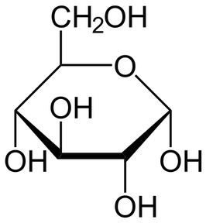
Sugars
Glucose (C6H1206) is the most common monosaccharide and is very important in the chemistry of life
Illustrates the trademarks of sugars:
Single Carbonyl group (C=O)
Multiple Hydroxyl groups (-OH)
Notes:
Picture Reference: http://www.stagesofsuccession.com/2012/07/remembering-glucose.html

Slide 12
Disaccharides
Composed of 2 monosaccharides joined together through glycosidic linkage
Notes:
Picture Reference: http://bealbio.wikispaces.com/Period+3+ch+5+Q

Slide 13
Polysaccharides
Polymers that are composed of multiple monomers.
Can range from a few hundred to a few thousand
Can serve in two main functions:
Storage material
Building material

Slide 14
Storage Polysaccharides
Sugar can be stored for later use in the form of storage polysaccharides
Plants and animals use different storage polysaccharides for their energy needs

Slide 15
Plant Storage Polysaccharides
Plants store sugar in the form of starch, which are long chains of glucose molecules
Since glucose is a major source of cellular fuel, starch represents stored energy
This storage system can be thought of as a bank account, where energy can be deposited and withdrawn as needed through hydrolysis and dehydration reactions
Most animals have enzymes that can break down plant starch so that it can be used for their energy needs

Slide 16
Animal Storage Polysaccharides
Animals store sugar in glycogen, which is similar to plant starch
Glycogen is mainly stored in the liver and muscles in humans and most vertebrates
The energy contained within glycogen cannot sustain an animal’s energy needs for very long
They must consume foods to replace their sugar reserves

Slide 17
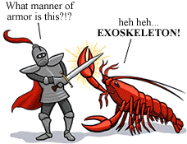
Structural Polysaccharides
Organisms can use polysaccharides to build cellular materials
Plants use a polysaccharide called cellulose as a major component for cell walls
Many insects and crustacean use the polysaccharide chitin to build their exoskeletons.
Notes:
Picture Reference: http://evolution.berkeley.edu/evolibrary/article/arthropods_06

Slide 18
Concept Check 5.2
Write the formula for a monosaccharide that has three carbons.
A dehydration reaction joins two glucose molecules to form maltose. The formula for glucose is C6H12O6. What is the formula for maltose?

Slide 19
Chapter Key Concepts
Macromolecules are polymers, built from monomers
Carbohydrates serve as fuel and building material
Lipids are a diverse group of hydrophobic molecules
Proteins include a diversity of structures, resulting in a wide range of functions
Nucleic acids store, transmit, and help express hereditary information

Slide 20
Lipids
Are a class of large molecules that are generally not large enough to be considered macromolecules.
Lipids are grouped together based on one factor:
They mix poorly in water

Slide 21
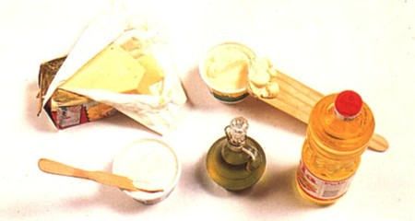
Fats
Fats are not polymers, they are large molecules built from smaller molecules through dehydration reactions
Fats are composed of two kinds of smaller molecules:
Glycerol (an alcohol)
Fatty acids
Notes:
Picture Reference: http://www.greenvitals.net/greenvitalsnet/2010/3/4/health-risks-rising-as-obesity-rates-triple-among-young-amer.html

Slide 22
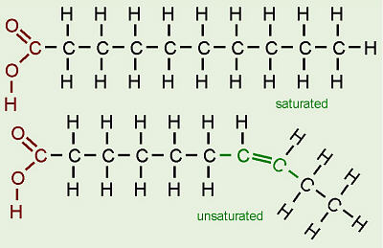
Fatty Acids
Composed of a long chain of carbon atoms (16-18)
One end has carboxyl group
Rest of skeleton is made up of hydrocarbon chains (C-H)
Notes:
Picture Reference: http://biology.clc.uc.edu/courses/bio104/lipids.htm

Slide 23
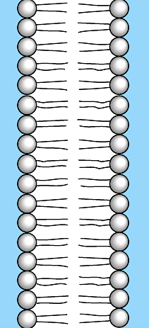
Phospholipids
Make up the cell membrane
Perfect example of how form fits function
Each end of a phospholipid has a different affinity toward water:
Hydrophilic head
Hydrophobic tail
Notes:
Picture Reference: http://medicine-science-and-more.com/lipid-medtabolism/

Slide 24
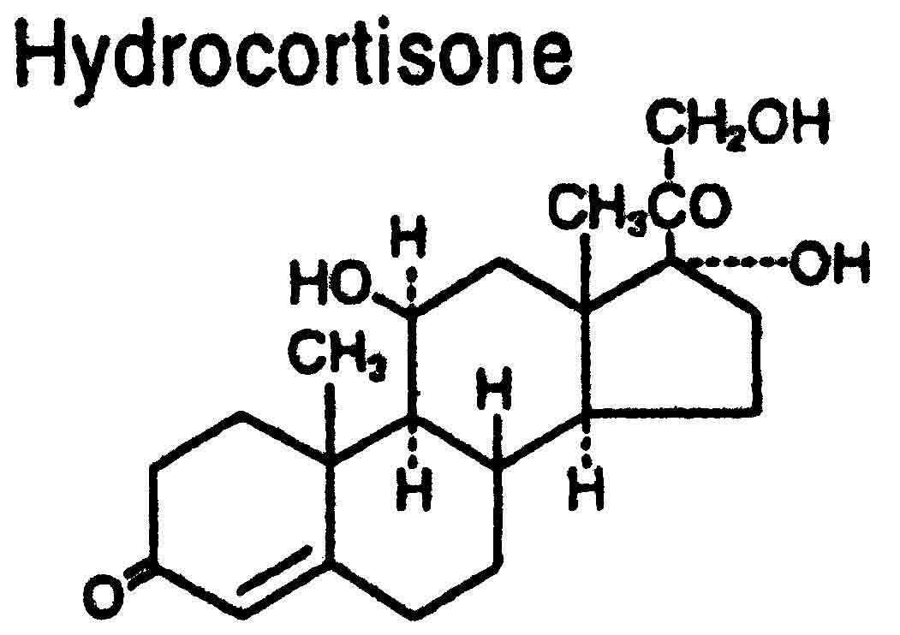
Steroids
Lipids characterized by structures composed of 4 rings of carbon atoms
Different steroids, such as cholesterol and human sex hormones, are distinguished by the different functional groups that are attached to the ring structure
Notes:
Picture Reference: http://www.drugs.com/pro/procto-kit.html

Slide 25
Concept Check 5.3
Compare the structure of a fat (triglyceride) with that of a phospholipid.
Why are human sex hormones considered lipids?

Slide 26
Chapter Key Concepts
Macromolecules are polymers, built from monomers
Carbohydrates serve as fuel and building material
Lipids are a diverse group of hydrophobic molecules
Proteins include a diversity of structures, resulting in a wide range of functions
Nucleic acids store, transmit, and help express hereditary information

Slide 27
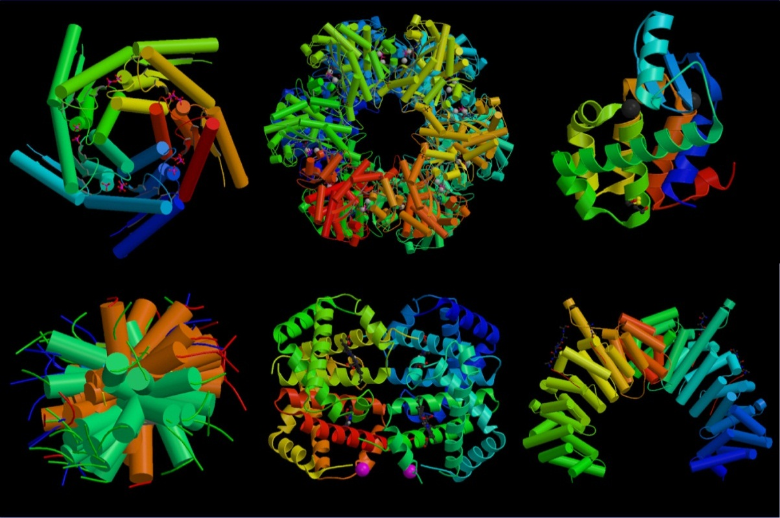
Proteins
Proteins account for more than 50% of the dry mass of most cells
Proteins serve in various roles such as speeding up reactions, storage, defense, cellular communication, and movement among others
Notes:
Picture Reference: http://martin-protean.com/protein-structure.html

Slide 28
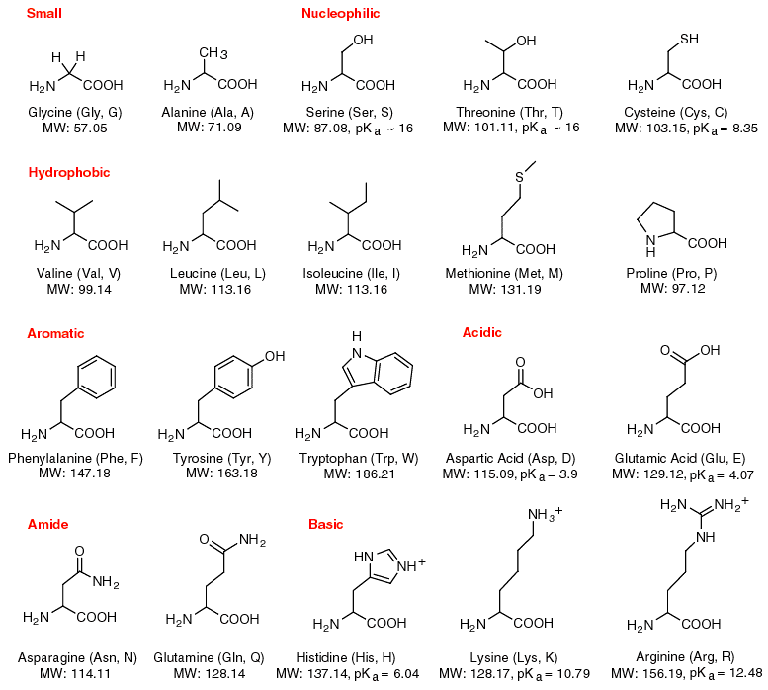
Polypeptides
There are 20 amino acids that compose all proteins
Polypeptides are polymers of amino acids, which form proteins when folded and coiled
Notes:
Picture Reference: http://matznerd.com/amino-acids/

Slide 29
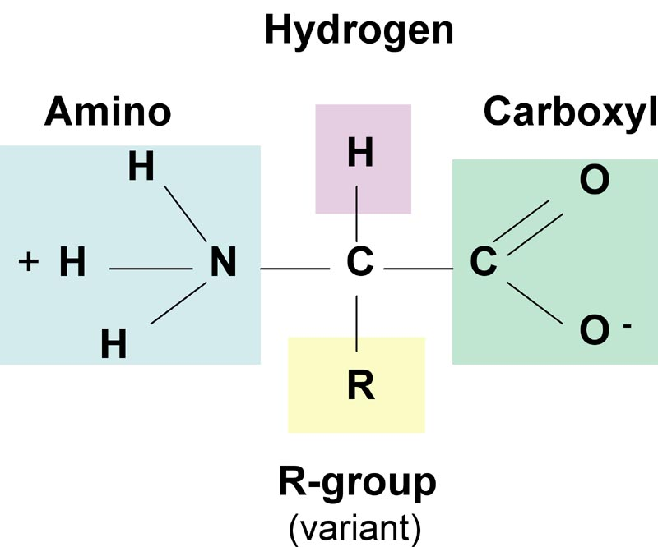
Amino Acid Monomers
All amino acids share a general structure
Notes:
Picture Reference: http://www.whitetigernaturalmedicine.com/nutrition/proteins-amino-acids

Slide 30
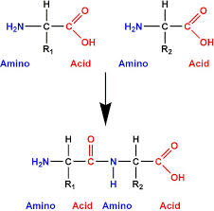
Amino Acid Polymers
Amino acid monomers are linked together to form polymers through peptide bonds
Notes:
Picture Reference: http://www.chemicalconnection.org.uk/chemistry/topics/view.php?topic=5&headingno=3

Slide 31
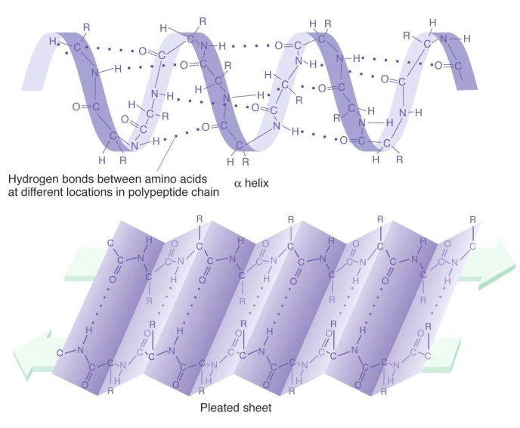
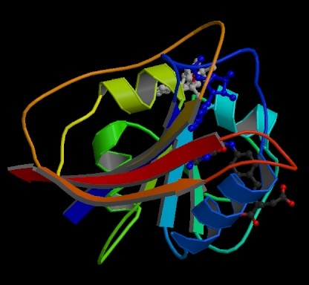
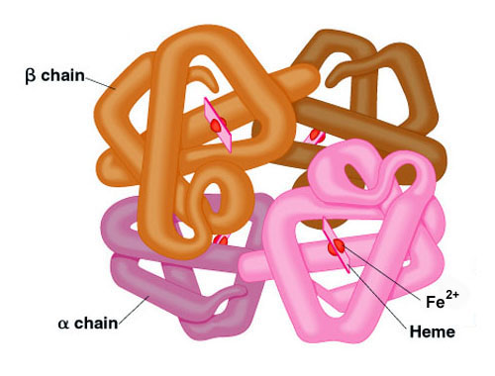
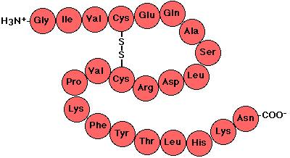
Protein Structure
The structure of a protein determines its function
There are four levels to protein structure:
Primary – Linear chain of a.a.
Secondary – α helixes and β sheets
Tertiary – 3D shape
Quaternary – Multiple polypeptides join together to form a functional protein
Notes:
Picture References:
http://users.rcn.com/jkimball.ma.ultranet/BiologyPages/P/PrimaryStructure.html
https://www.mun.ca/biology/scarr/MGA2_03-18b.html
http://www.chemguide.co.uk/organicprops/aminoacids/proteinstruct.html
http://schoolworkhelper.net/protein-structures-primary-secondary-tertiary-quaternary/

Slide 32
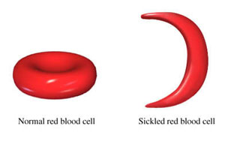
Sickle Cell Disease
Sickle cell disease is an example of a small change in the protein structure that effects its shape and ability to function
Caused by a single valine a.a. being substituted for glutamic acid in the primary structure of hemoglobin
Notes:
Picture Reference: http://www.thehabarinetwork.com/jamaica-looking-into-carbon-monoxide-treatment-of-sickle-cell-anaemia

Slide 33
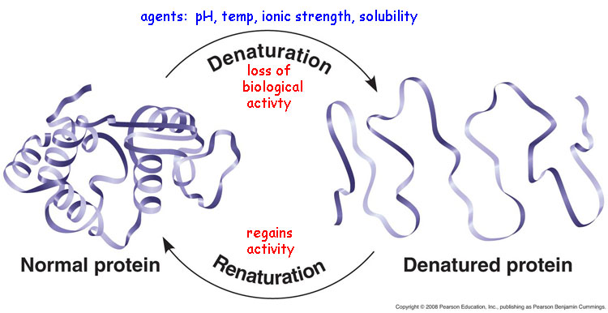
Changes in Protein Structure
Various causes can affect the shape of proteins
Changes in salt concentration and temperature can cause a proteins structure to change or break down
This process is known as denaturation
Notes:
Picture Reference: http://chronicsci.tumblr.com/post/35396386419/protein-denaturation-proteins-loose-their-3d

Slide 34
Concept Check 5.4
Why does a denatured protein no longer function normally?
What parts of a polypeptide participate in the bonds that hold together secondary structure? Tertiary structure?

Slide 35
Chapter Key Concepts
Macromolecules are polymers, built from monomers
Carbohydrates serve as fuel and building material
Lipids are a diverse group of hydrophobic molecules
Proteins include a diversity of structures, resulting in a wide range of functions
Nucleic acids store, transmit, and help express hereditary information

