Slide 1
Lab 9 Human Senses
BY-102
Zach Nolen

Slide 2
Activities to Compete
Vision
Walk blind folded
Test peripheral Vision
Test – color vision – Ichikawa test.
Test consensual light reflex
Determine your blind spot
Test depth perception
Determine your dominant eye
Mixing of images
Optical illusions
Vision disk
Smell
Smell Beads
Touch
Thermoreception
2-point threshold
Upper arm
Fingertip
Back of hand
Nape of neck

Slide 3
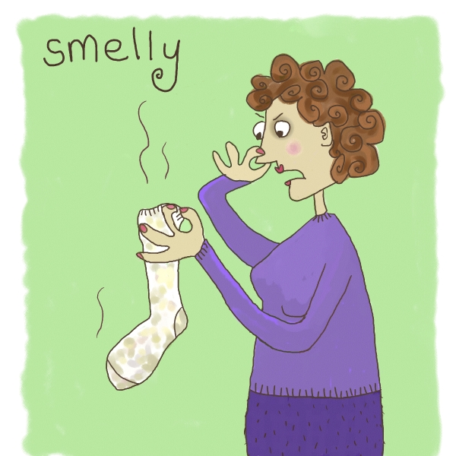
The 5 Senses
Hearing
Taste
Smell
Vision
Touch

Slide 4
Sensory Organ and Receptors
All senses involve:
Sensory stimulus
Sense organ with receptors
Nerve impulse to the brain
Interpretation by the brain.

Slide 5
Sensory Organ and Receptors
Hearing
Ear - Mechanoreceptors
Taste
Tongue - Chemoreceptors
Smell
Olfactory rods of nose – Chemoreceptors
Touch
Skin – Mechanoreceptors and Chemoreceptors
Vision
Eye - Photoreceptors

Slide 6
Hearing

Slide 7
How hearing works
Link to video
http://www.youtube.com/watch?v=qgdqp-oPb1Q

Slide 8
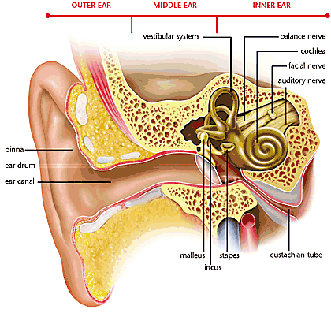
Balance

Slide 9
Taste

Slide 10
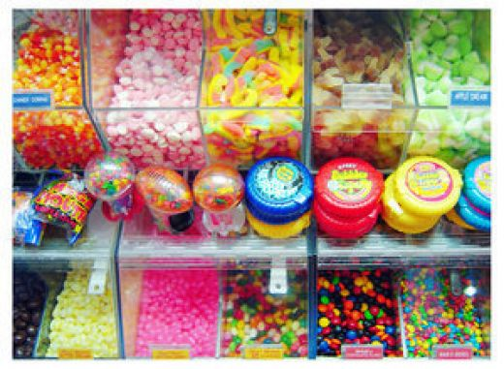
What Can We Taste?
We can taste chemicals that are:
Sweet
Salty
Sour
Bitter
Umami (savory)

Slide 11
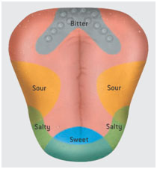
Old vs. New Hypothesis
Old Hypothesis
New Hypothesis

Slide 12
Smell

Slide 13
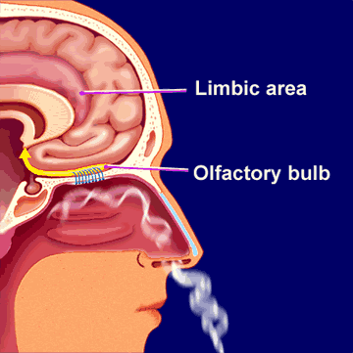
How Smell Works
Chemicals in the air
Chemoreceptors in top of nose
Olfactory nerve

Slide 14
Exercise – Smell Beads
For this exercise, we will be trying to identify various scents.
Smell each set of smell beads at your table and see if you can identify all 10.
After you smell each set, make sure to smell the coffee to cleanse your pallet.

Slide 15
Touch

Slide 16
How Touch Works
We can feel many different things:
Pressure, pain, heat, and cold
Involves Mechanoreceptors and Thermoreceptors
Skin (largest sense organ)
Many different nerves throughout the body

Slide 17
Exercise E – Two Point Threshold
For this exercise we will be looking at the two point threshold at various areas.
Two point threshold is the smallest separation at which 2 stimuli can be perceived as distinct.
To test:
One person closes their eyes
Touch various parts as listed on p.101 using the provided ruler.
Gradually decrease the distance between the 2 points until the 2 points are no longer distinct.
Record the distance in lab manual

Slide 18
Vision

Slide 19
How Vision Works
Link to video
http://www.youtube.com/watch?v=gvozcv8pS3c

Slide 20
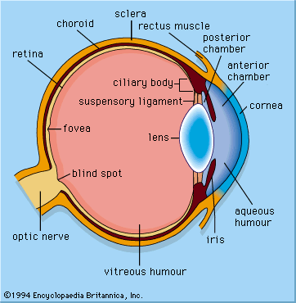
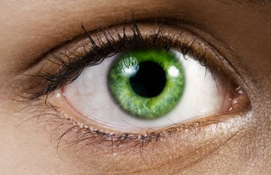
Eye Structures
Recall last week the structures that we looked at.

Slide 21
Exercise A – Walking Blindfolded
Work in pairs
One partner will blindfold the other and lead the other around the hallway.
Switch places so the other partner is blindfolded.
Please be careful!
After each person has walked around, you will come back to your station and write down your observations.

Slide 22
Vision Disorders
Myopia (Nearsightedness)
Hyperopia (Farsightedness)

Slide 23
Vision Disorders
Cataracts
(protein build up)
Glaucoma
(Increased eye pressure)

Slide 24
Review Questions
What are the 5 senses, what organs are involved in each sense, and what kind of receptors are associated with each sense?
What is the 2 point threshold?
What section of the ear is involved in balance?
What are some examples of vision disorders?

Slide 25
Activities to Compete
Vision
Walk blind folded
Test peripheral Vision
Test – color vision – Ichikawa test.
Test consensual light reflex
Determine your blind spot
Test depth perception
Determine your dominant eye
Mixing of images
Optical illusions
Vision disk
Smell
Smell Beads
Touch
Thermoreception
2-point threshold
Upper arm
Fingertip
Back of hand
Nape of neck

Slide 26
Before You Leave Lab
Clean up your work station
Straighten up all objects used during the lab

Slide 27
Before Next Lab
Read Lab 10 – Food Web
Do online prelab
Complete notebook sections for lab manual check

